Slide 1


Power Consumption Analysis For House Holds
By:- Team 4
Team members:
Dhruv Arora | Naman Arora | Asif Ali Sherani |
Vishwakarma Manishkumar Durbhash | Krishna Agrawal

Slide 2
Introduction
India is the world's third largest producer and third largest consumer of electricity.
The gross electricity consumption in 2018-19 was 1,181 kWh per capita.
Energy use can be viewed as a function of total GDP, structure of the economy and technology.
To achieve reduction in electricity consumption, it is vital to have current information about household electricity use.
Average annual site energy use per home has declined in the past few years.
The reasons for this decline are:
Improved efficiencies of heating and cooling equipment, water heaters, refrigerators, lighting, and appliances

Slide 3
Proposed work
Our idea is to create a model which is trained by the available data and predict the household consumption .
There would be five inputs namely Global_reactive_power, Global_intensity, Sub_metering_1, Sub_metering_2, Sub_metering_3.
It is a regression problem and the model is used accordingly.

Slide 4
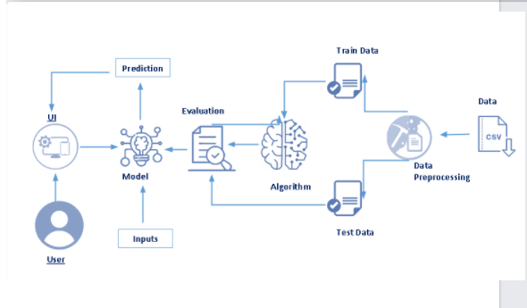
Block Diagram

Slide 5
Software Designing:
NumPy and Pandas : Open source data analysis and manipulation tool, built on top of the Python programming language.
Matplotlib and Seaborn : Used for visualization with python.
The finalized model is now to be saved. We will be saving the model as a pickle or .pkl file.
app.py flask file which is a web framework written in python for server-side scripting.

Slide 6
Applications:
To asses the energy efficiency and energy usage of their homes.
To use the new understanding of the problem to consider different framings of the prediction problem, ways the data may be prepared, and modeling methods that may be used.

Slide 7
Conclusion
When we provide Input to the Model then using the input provided by the user it will predict the Global Active Power.

Slide 8
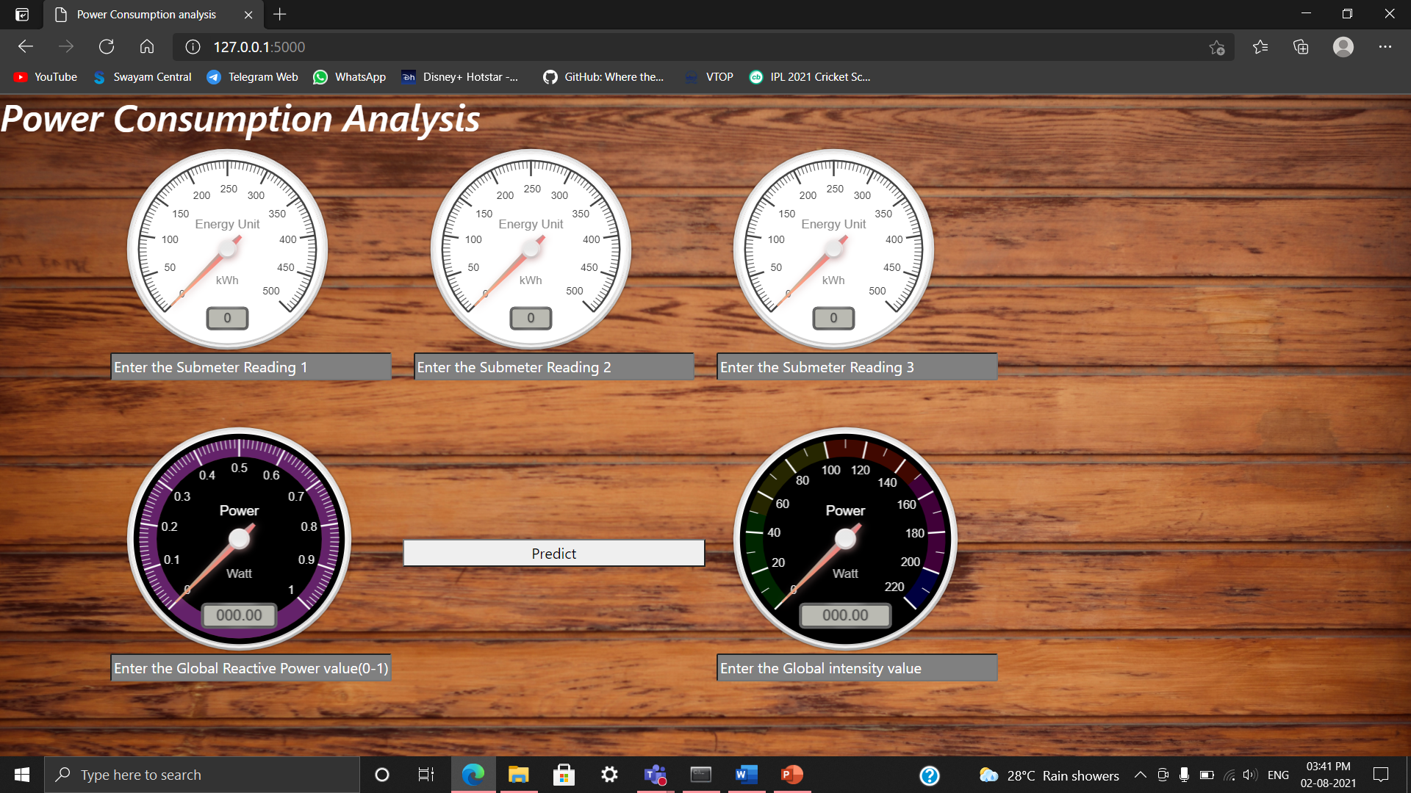
Snapshot

Slide 9
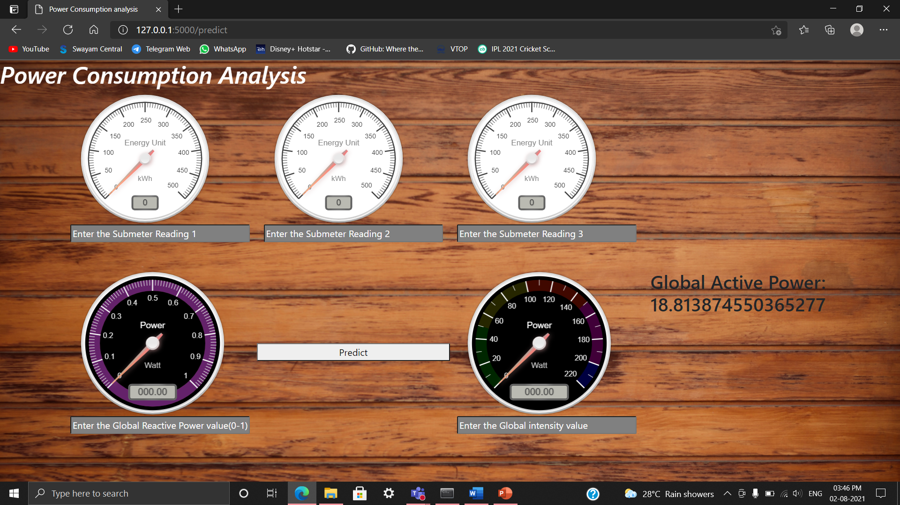
Output Snapshot

Slide 10
THANK YOU

